Slide 1
Predicting Future Rent Prices Based on Historic Averages
By: Thomas Fitzgerald

Slide 2
Significance
Should I terminate my lease or renew?
Renewal required months before end of lease
Give more time to prepare for rent increases

Slide 3
Background Research
LSTM, Feed-Forward, CNN
Analyzed factors affecting rent
Little help in how to predict

Slide 4
Dataset
Information retrieved from rentdata.org
Contained averages going to 2016

Slide 5
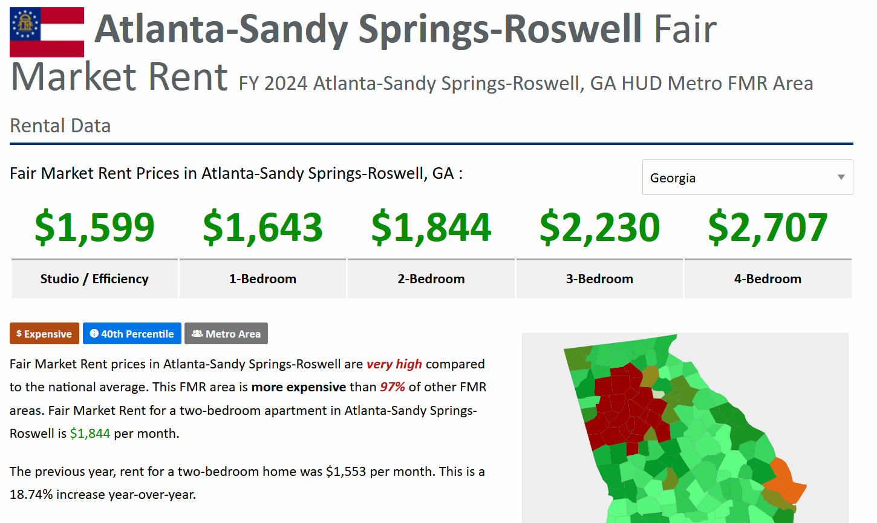
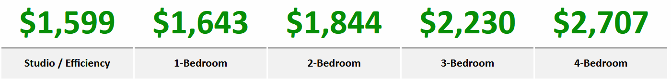
Dataset
Information retrieved from rentdata.org
Dataframe made of rent averages
5,565 data points
2024 Cherokee Average Rent Prices

Slide 6
Dataset
Information retrieved from rentdata.org
Contained averages going to 2016
Dataframe made of rent averages
5,565 data points

Slide 7
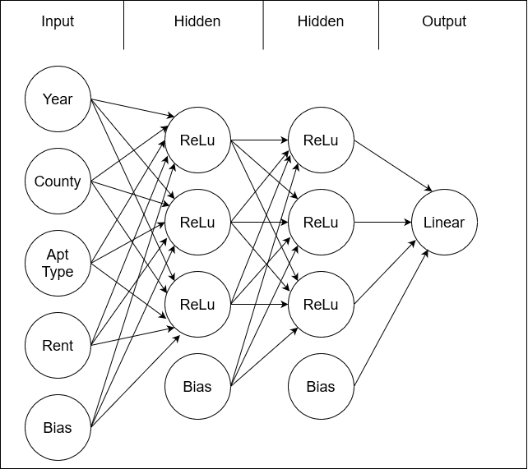
Model: Multilayered Perceptron
Normalization layer after each hidden
Mean Absolute Error Loss
Batches of 32 with 100 epochs

Slide 8
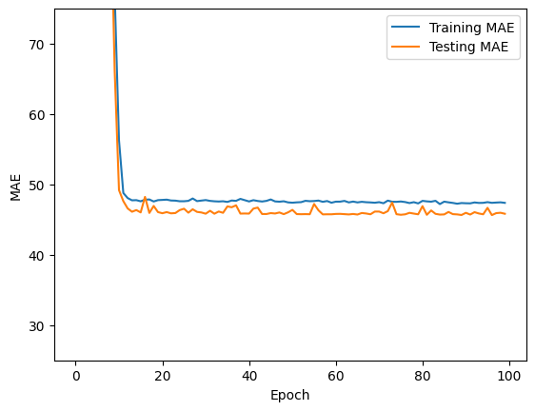
Performance
Quickly approached absolute minima
Final MAE of $45.58
Final MAPE of 5.32%

Slide 9
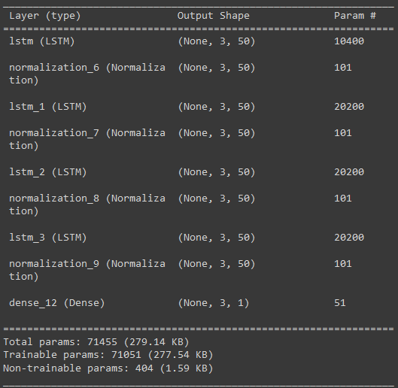
Comparison to Other Models: LSTM
Constructed LSTM model for dataset
Final MAE of $35.58
Final MAPE of 4.04%

Slide 10
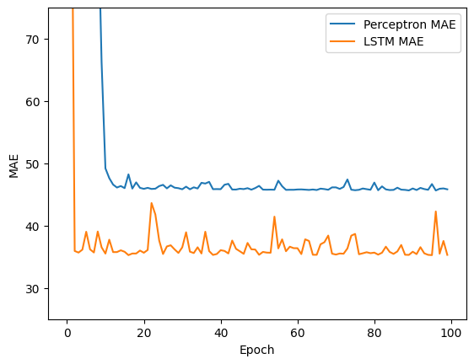
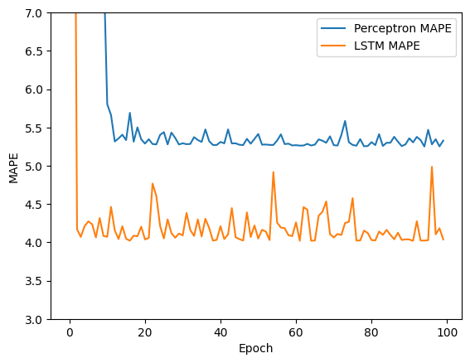
Comparison to Other Models: LSTM
Perceptron took 83 sec, LSTM took 129 sec

Slide 11
Conclusion
LSTM model was marginally more accurate
Perceptron was significantly faster
Sizeably more accurate than background research

Slide 12

Thank You For Your Time

